Slide 1
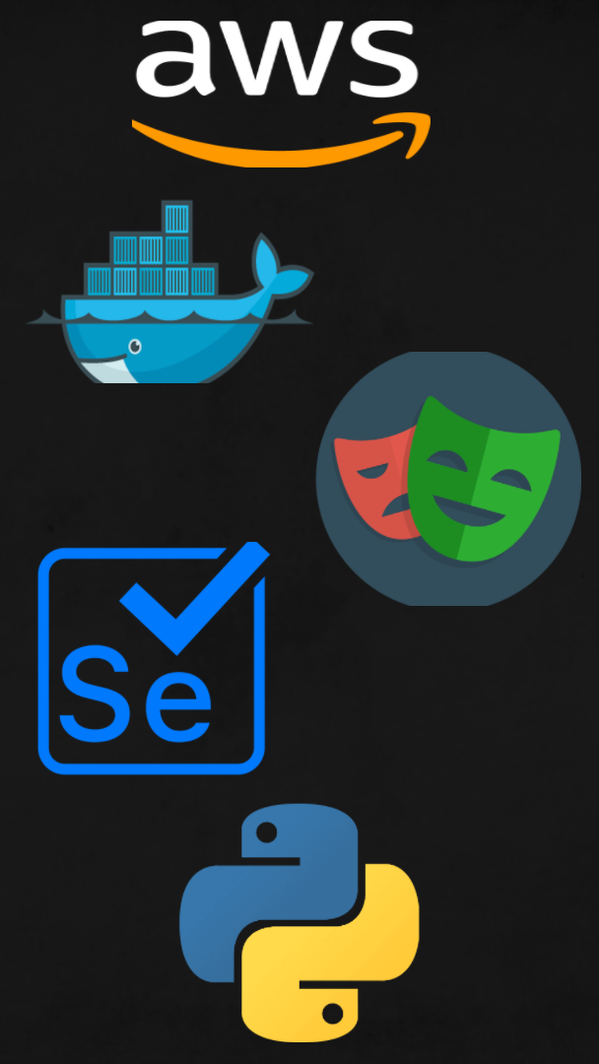

Debdip Bandyopadhyay (M22AI845)
Arvind Sriram G (M21AIE218)

Slide 2

- Web applications need to be tested on a wide variety of browsers and OS environments to ensure compatibility and functionality.
- However, testing web applications is costly and time-consuming, as technology is rapidly changing and platforms are frequently updated.
- How can we reduce the testing time and cost, and improve the testing quality and reliability?

Slide 3
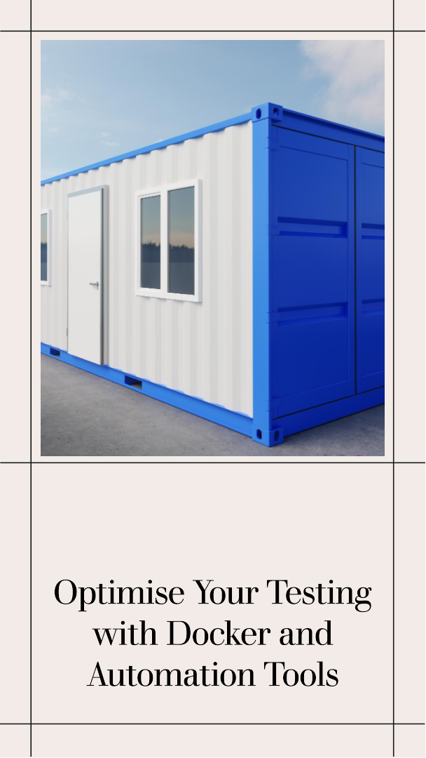
- We propose to use Docker and test automation tools, such as Playwright and Selenium, to run multiple tests in parallel and in different versions of browsers, including some beta versions.
- Docker is a tool that allows us to create, run, and share containers that package our code and dependencies. Containers are lightweight and isolated software components that can run on any platform and environment.
- Playwright and Selenium are frameworks for web automation and testing. They allow us to interact with the web applications and verify their behaviour and functionality.

Slide 4

- By using Docker and test automation tools, we can achieve the following benefits:
- Speed: We can run our tests faster by using standardized and reusable containers that can be easily built, deployed, and managed. We can also run our tests in parallel and in different browsers and environments, without having to install and maintain them on our local machine or server.
- Reliability: We can run our tests more reliably by using containers that can run the latest versions of browsers and dependencies, and also isolate the tests from the host system and other applications. We can also use features and capabilities that can help us test the web applications and their responses to different scenarios.

Slide 5
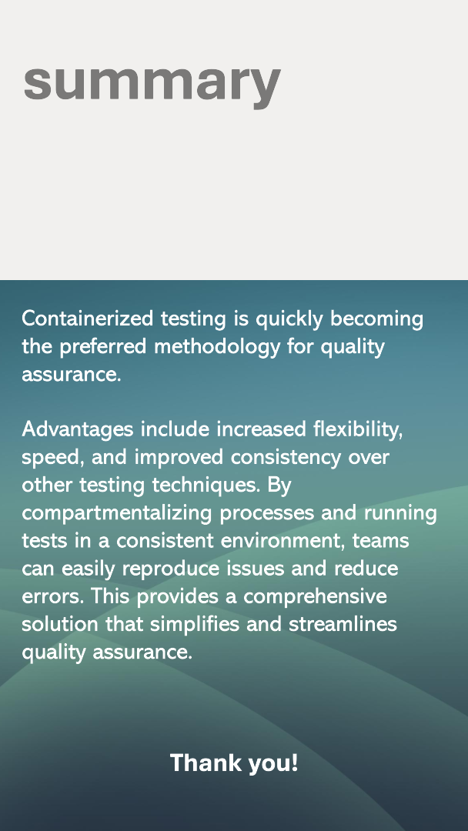
- In conclusion, we have proposed a solution to reduce the testing time and cost, and improve the testing quality , reliability and coverage, of web applications on a wide variety of browsers and OS environments.
- We have used Docker and test automation tools, such as Playwright and Selenium, to run multiple tests in parallel and in different versions of browsers, including some beta versions.
- We want to achieve the benefits of speed, reliability, and cost by using this solution.
- We hope that our project will help us and others to test web applications more efficiently and effectively.

